Slide 1
THIS + NEXT WEEK:
Nuclear Magnetic Resonance (NMR) spectroscopy
applied to Structural Biology
Luciano Abriata – Lab. for Biomol Model. / PTPSP facility / NMR facility
These classes are not at all deep (whole courses can be done dedicated to different sub-fields of NMR spectroscopy)…
… but neither are them too shallow: I try to balance practical applications with giving you some basic theoretical concepts.
NEW IN 2024: Blog posts with a written form of everything I tell you here
CHAPTER 1: https://medium.com/advances-in-biological-science/nuclear-magnetic-resonance-spectroscopy-the-overlooked-powerhouse-of-biology-chapter-1-7b3d74dad714
CHAPTER 2: https://medium.com/advances-in-biological-science/nuclear-magnetic-resonance-spectroscopy-the-overlooked-powerhouse-of-biology-chapter-2-f1e80e7a4b3
CHAPTER 3: https://lucianosphere.medium.com/nuclear-magnetic-resonance-spectroscopy-the-overlooked-powerhouse-of-biology-chapter-3-5fed9865afce
CHAPTERS 4 & 5: COMING SOON

Slide 2
CLASS 1 (today): Intro to Nuclear Magnetic Resonance for proteins
including an exercise on interpreting a protein-protein titration
Tomorrow: 8:15 at the NMR facility, then we come here to measure remotely
CLASS 2 (next week): More exotic bio-NMR: ligand screening, disordered proteins & biochemistry at atomic level
including an example application

Slide 3
Part 1
Nuclear Magnetic Resonance
as one more Spectroscopic tool

Slide 4
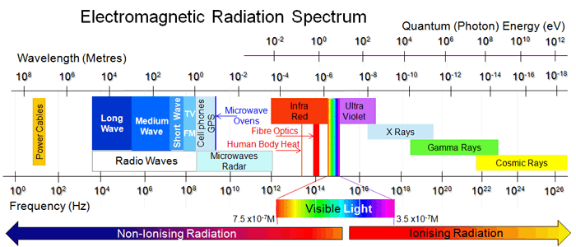
Spectroscopy = study of how energy interacts with matter
Absorption, Emision, Scattering, etc
Quantified as spectra →
Tools for chemistry &
structural biology ←
Energy, frequency, wavenumbers, etc.

Slide 5
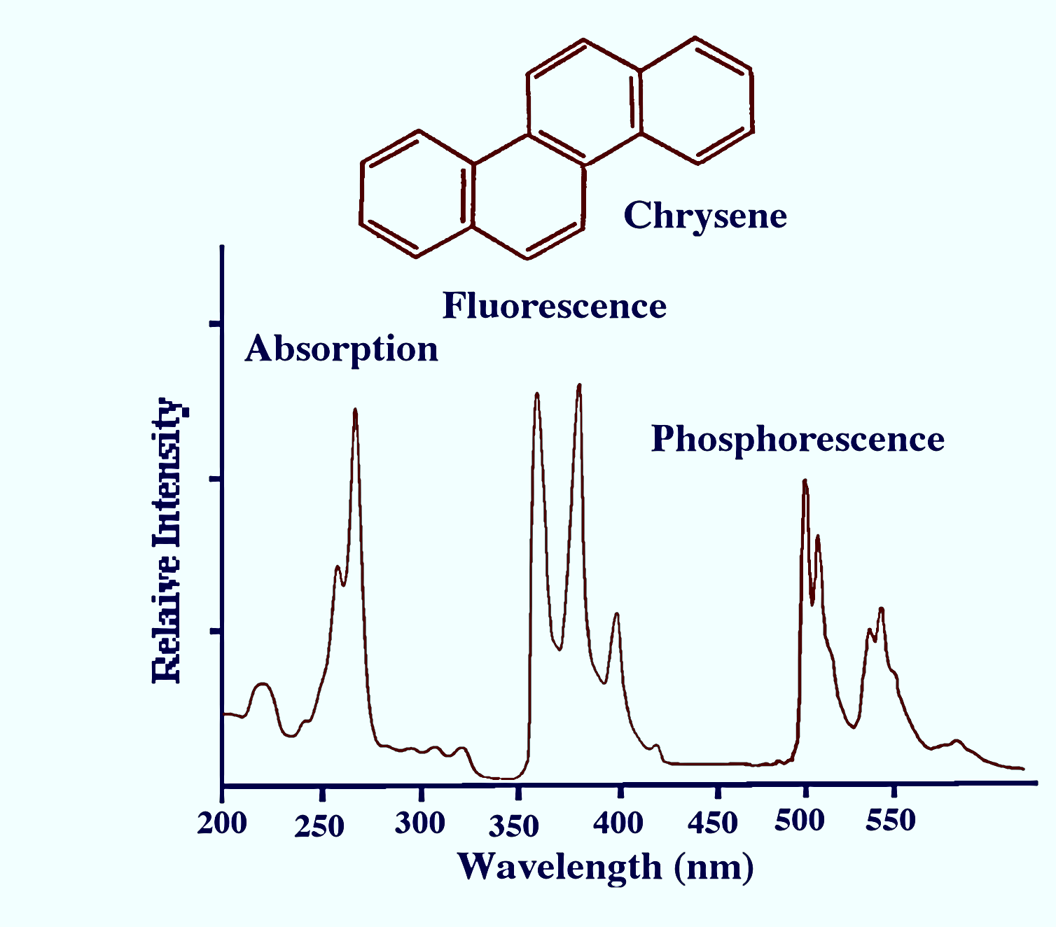
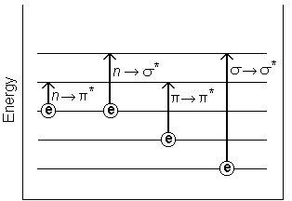
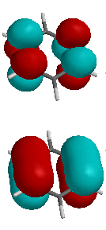
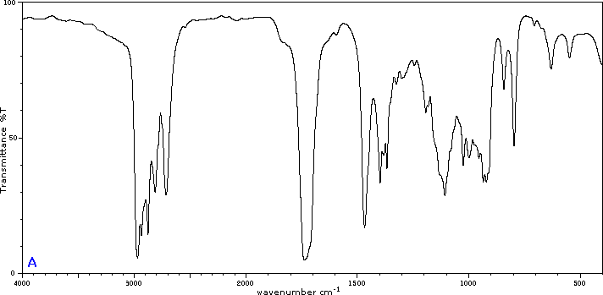
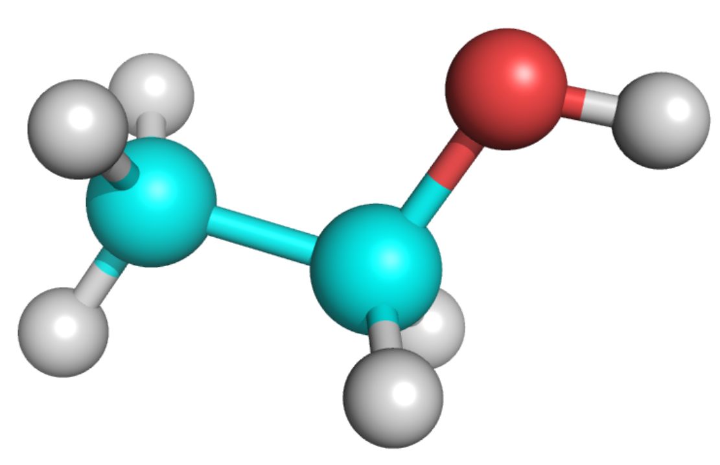
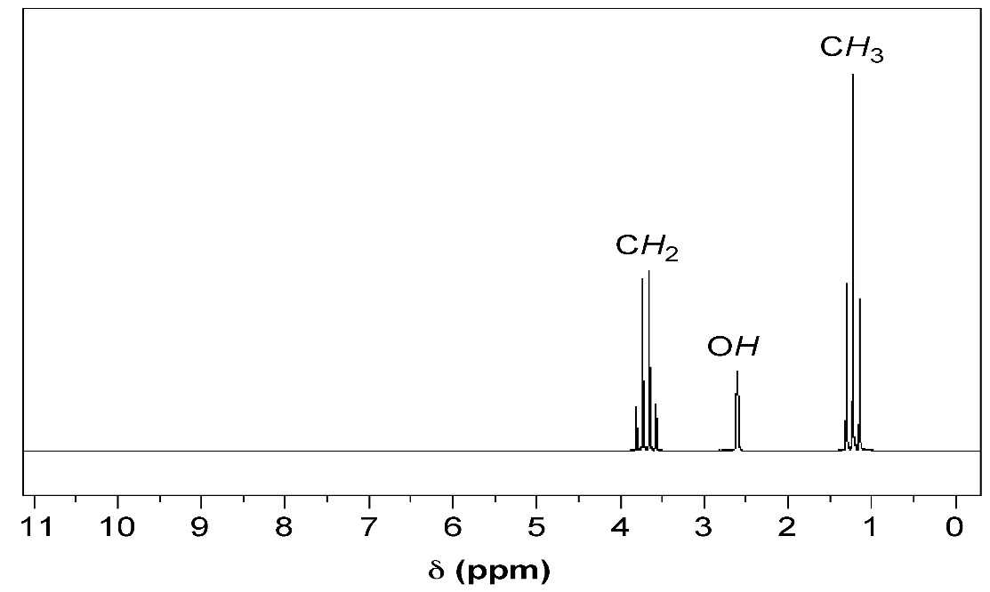
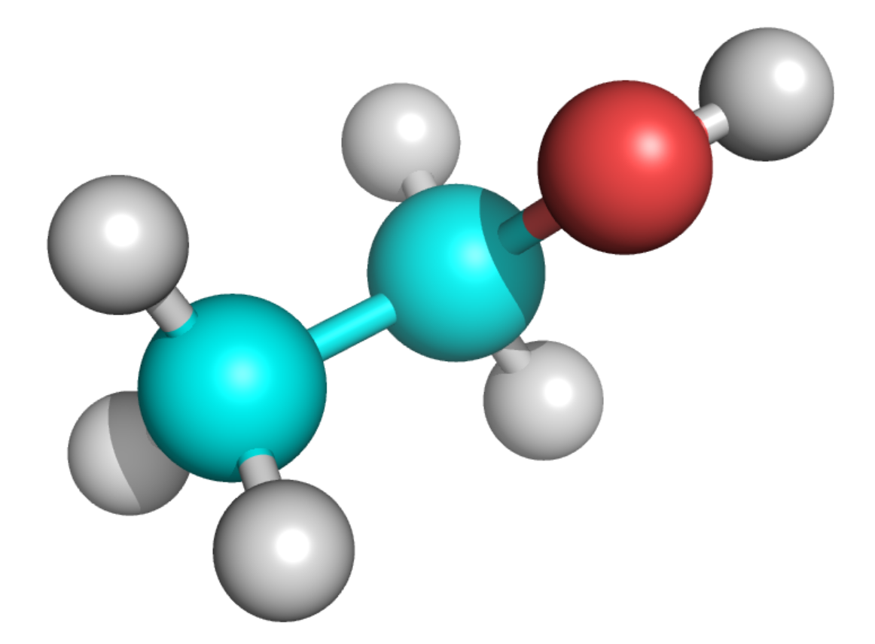
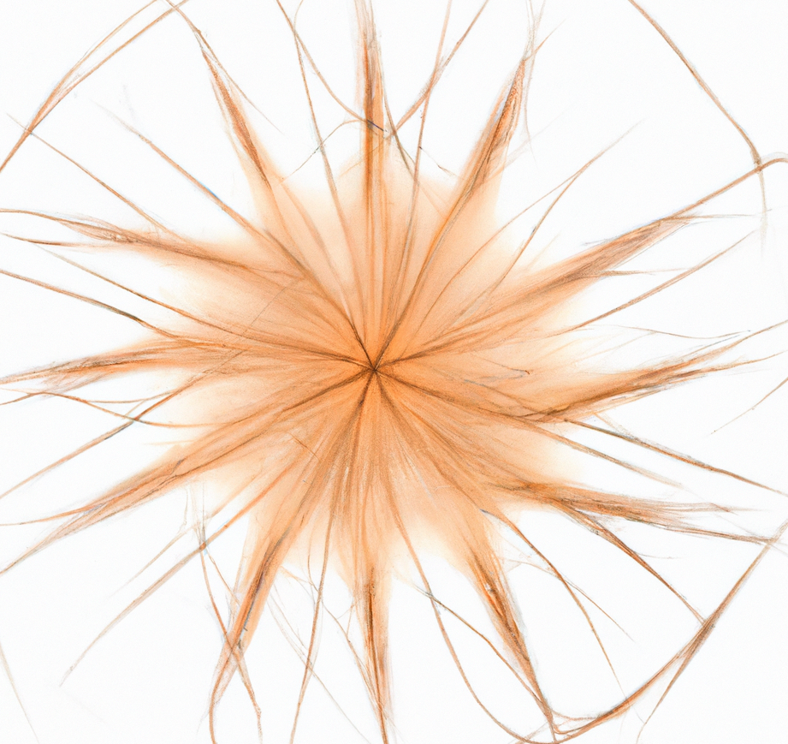
Wavelength = c/frequency
Electronic spectroscopies
Wavenumbers = 1/wavelength
Wavelength = c/frequency
Chemical shift = c x frequency

Slide 6
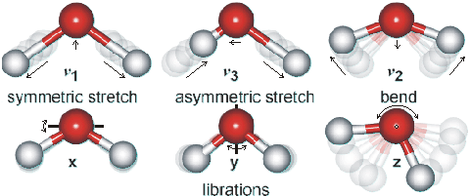
Infrared spectroscopies
Transmittance
Wavenumbers = 1/wavelength

Slide 7
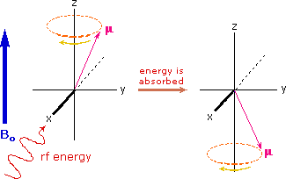
Magnetic spectroscopies (NMR, EPR)
In the classical analogy of all these quantum systems,
nuclei & electrons behave as tiny precessing magnets
Static (external) magnetic field
Chemical shift = c x frequency

Slide 8

Increasing energy
¹⁵N nucleus
¹³C nucleus
¹H nucleus
electron
¹⁵N NMR
¹³C NMR
¹H NMR
EPR
Nuclear Magnetic Resonance
Electron Paramagnetic Resonance

Slide 9
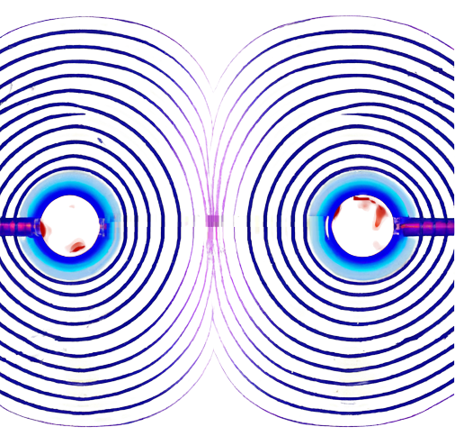
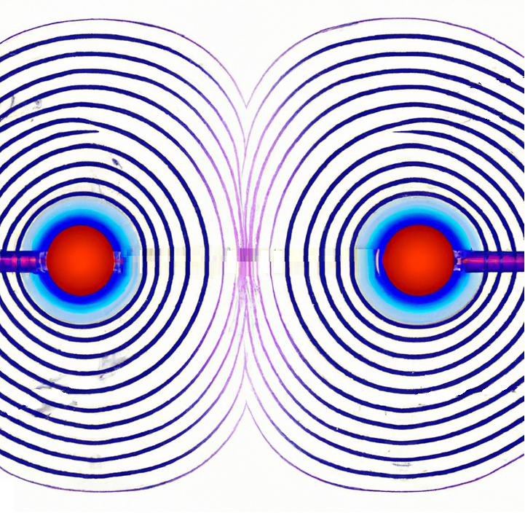
NMR sample
Magnetic field lines
Magnetic field is strongest here
Magnet’s coil

Slide 10
Put S>0 nuclei in a magnetic field and you can do NMR
B_{o}
S=1/2 => m_{s} = +1/2 or -1/2
S=nuclear spin m_{s}=quantum spin number

Slide 11
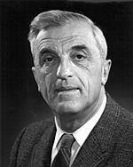
NMR-active nuclei, best spin=1/2
F. Bloch
Natural abundance
Relative sensitivity
Absolute sensitivity
Isotope
Spin
¹H ¹³C ¹⁵N ³¹P

Slide 12

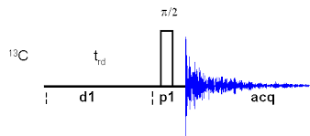
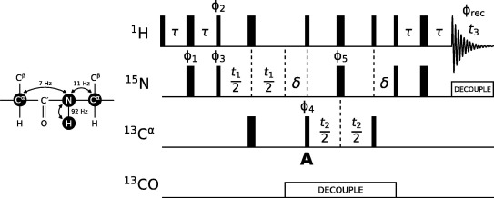
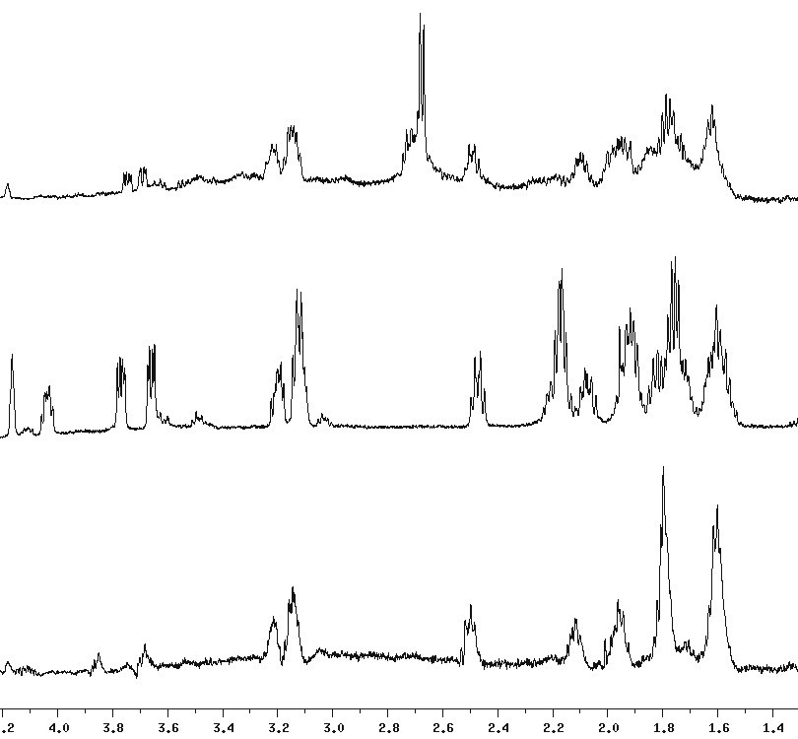
NMR instr. is basically a huge magnet
with expensive radio equipment
(Actually a superconducting magnet in liquid helium)
Excite resonances (+ possibly encode information)
Read signal (“Free Induction Decay”)
Fourier Transform
Spectrum
N
To manipulate magnetization and record signals (“pulse sequences”)
B_{o}
Time
Frequency
Magnet
B₁
Recorder
Frequency
Generator
S
Detector

Slide 13
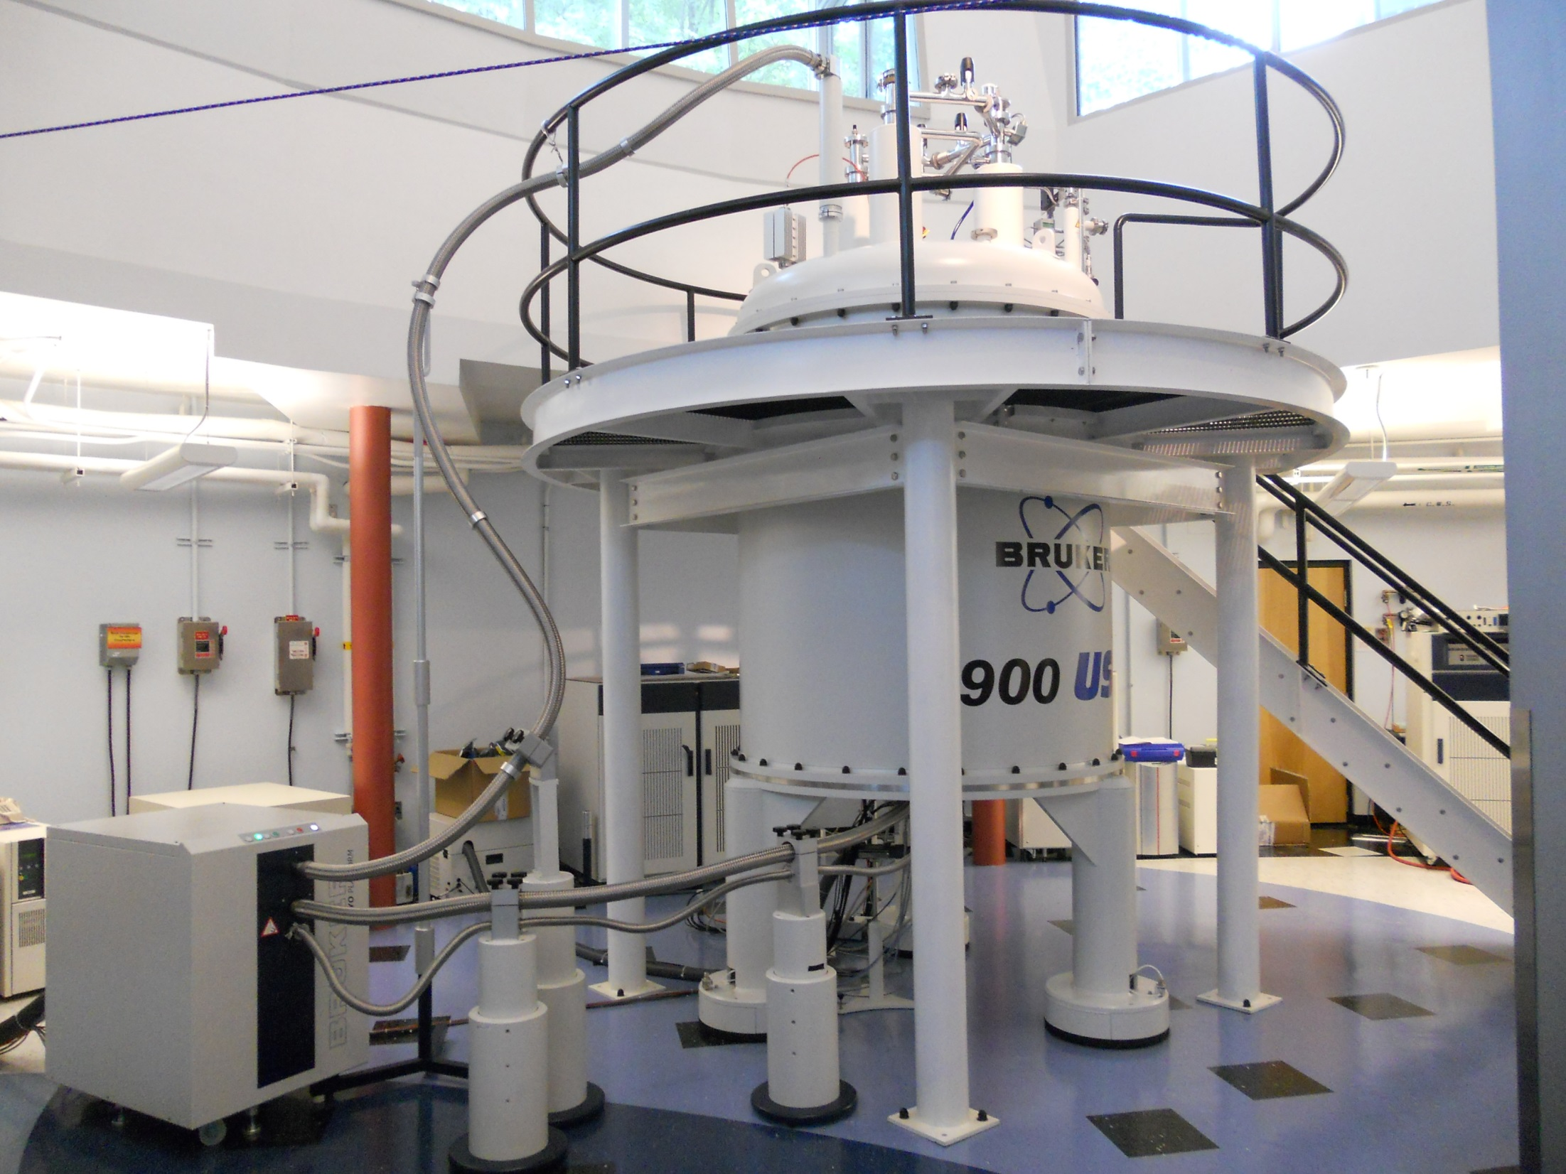

Slide 14
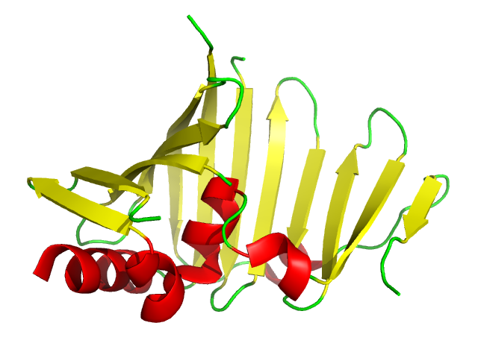
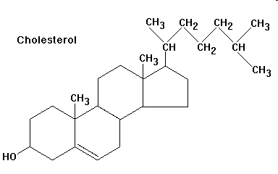
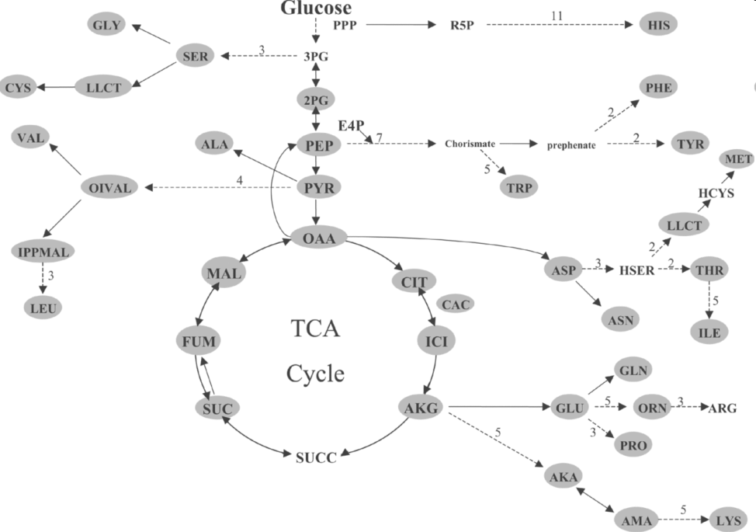
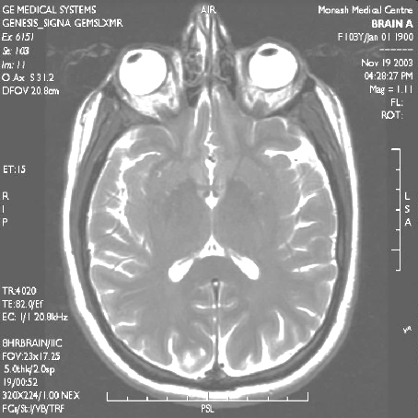
Nuclear Magnetic Resonance in Biology
¹H ¹³C ¹⁵N ³¹P
< 1%
Notes:
The NMR phenomenon can be used in many ways. It’s the basic of MRI, which we will not cover but there are labs working on that here. Then one clear application is in solving structures of small molecules, and I wanted to highlight here that since these are very easy spectra, very different for different molecules, you can relatively easily analyze complex mixtures of them and then track in real time how they evolve, so you can monitor a chemical process, metabolism, etc. The last application, most relevant to this talk, is about studying the structure, dynamics, interactions, etc of proteins.

Slide 15
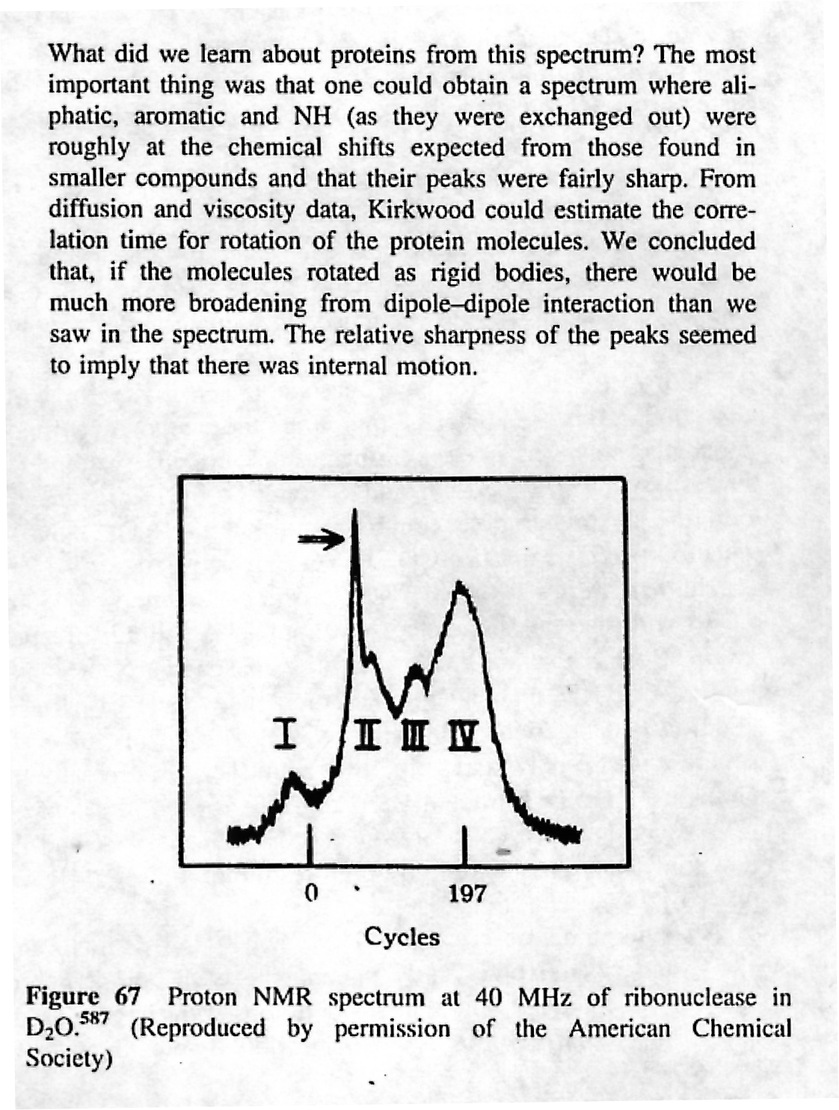
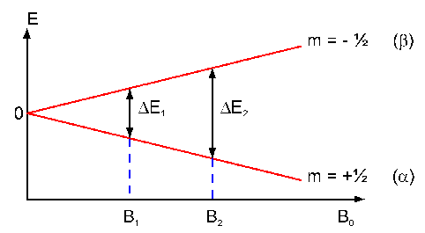
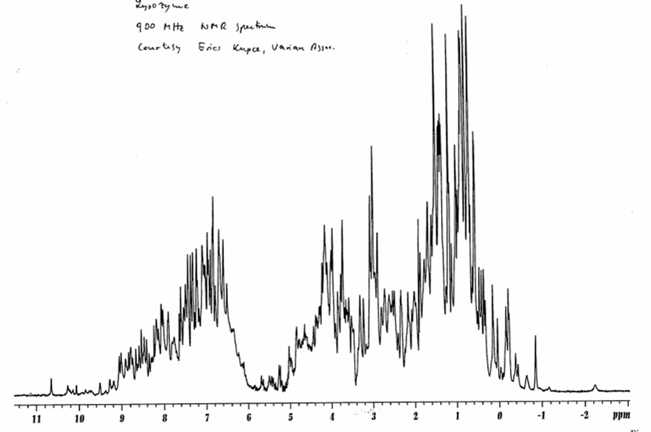
NMR spectroscopy → energy levels
(In this case induced by magnetic field)
1 T = 50 MHz ¹H
Δ E = γ h B_{o} / 2π = hν
10 T = 500 MHz ¹H
Ribonuclease, 15% concentration (around 10 mM), in D₂O to remove H₂O signals.
Saunders, Wishnia & Kirkwood, JACS (1957) 79:3289
γ : Gyromagnetic constant
Lysozyme < 1mM at 900 MHz in H₂O (suppressed by pulse sequence)
Larger gyromagnetic constant or larger external field → higher frequency → higher sensitivity & resolution

Slide 16
ΔE is small so NMR has low sensitivity!
To improve signal/noise:
Use concentrated samples
VERY strong magnetic field: 10s of Tesla
Use nuclei with large γ ¹H > ¹³C > ¹⁵N
May need to enrich: ¹H almost 100%, ¹³C and ¹⁵N ~ 1%
Average signals many times → long experiments (days!)
Protein stable and unchanged for experiment time

Slide 17
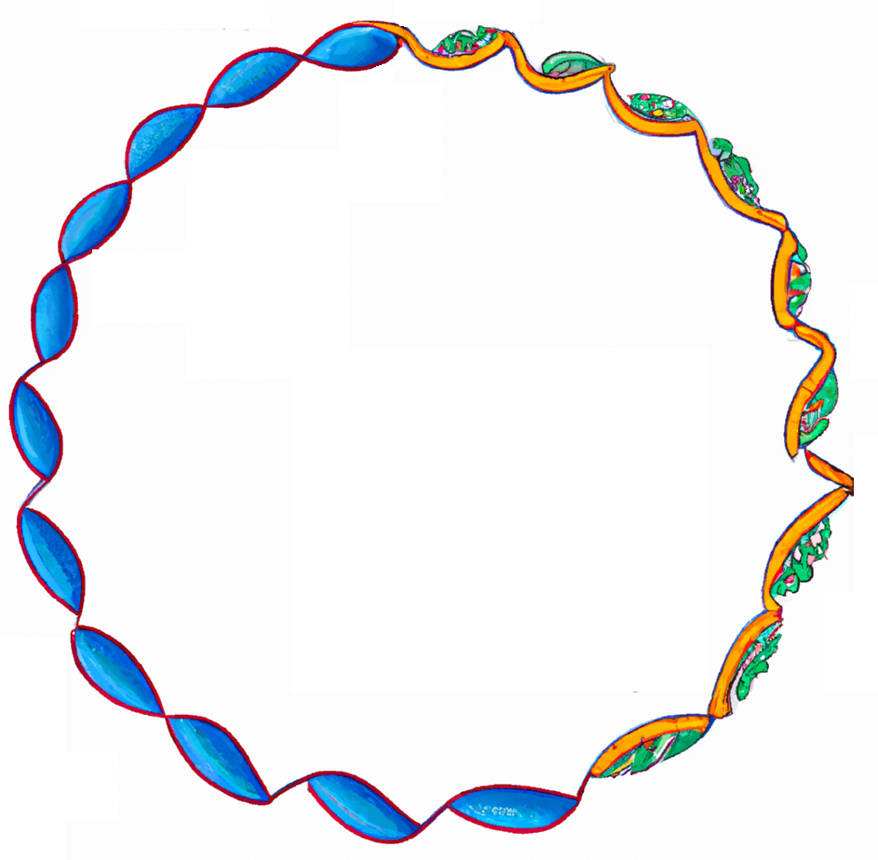
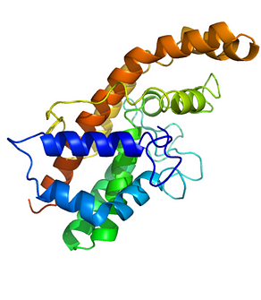
Methods for Isotope Enrichment (a.k.a. “labeling”)
Purpose: to produce protein sample enriched in ¹⁵N, ¹³C and/or ²H.
Biosynthetic methods preferred.
Host organisms: Bacterial (E. coli), Yeast, Fungal, Insect or Mammalian cells; Algae or cyanobacteria. Production in E. coli dominates (>95%)
Labeling reagents: ¹⁵NH₄Cl, [¹³C]glucose, D₂O.
Requires high expression in minimal media
Extra $ (¹³C > ¹⁵N)
→ Ask at Protein Structure Core Facility
Gene coding protein
DNA
RNA
Protein
¹⁵NH₄
¹³C-glucose
Notes:
A pesar de la gran revolución que representó la RMN bidimensional, y los primeros ejemplos de estructura de proteínas, cuando los investigadores se enfrentaban a moléculas de mayor tamaño, no era posible asignar todas las frecuencias de los protones que las constituían, porque los espectros contenían demasiadas señales. Era necesario utilizar otros núcleos activos desde un punto de vista RMN, como el C-13 o el N-15 para “editar” los espectros (ya veremos cómo), pero este tipo de trabajos no pudo ser realizado hasta que no se desarrollaron protocolos para marcar las biomoléculas (al principio sólo proteínas) y enriquecerlas artificialmente con estos núcleos de baja abundancia natural. También la parcial deuteración ayudaba a simplificar los espectros y ya volveremos sobre este argumento más adelante.
Dado que la síntesis química de proteínas es un proceso altamente ineficiente, se recurrió a métodos biosintéticos, en los cuales se introduce la información genética para la producción de la proteína de interés en un organismo huésped, que puede ser una bacteria, una levadura, un hongo, un insecto o incluso células de mamífero, algas o cianobacterias. Este organismo crece en un medio en el cual su fuente principal de nitrógeno es una sal de amonio con nitrógeno 15, su fuente de carbono es glucosa marcada con carbono 13 y en ciertos casos se usa agua pesada en lugar del agua normal. Estos núcleos se incorporan así a todas las proteínas que fabrica el organismo, y también a la proteína de interés que viene luego purificada.

Slide 18
Part 2
NMR spectra(l features) ←→ Structure

Slide 19
NMR and molecular structure
One nucleus
One signal (or “resonance”)
→ Each resonance reports about one atom (its covalent and noncovalent environment, its motions, etc.)

Slide 20
The 3 main signal features that are sensitive to structure and motions
400 MHz
100 MHz
40 MHz
¹H
¹³C
¹⁵N
Each nucleus has its main frequency, whose exact value depends on its chemical environment: CHEMICAL SHIFT
Nuclei are “coupled” through bonds and space: COUPLINGS
Excited nuclei relax through processes regulated by their motions → RELAXATION

Slide 21
(1) Chemical shift = slight variation in resonance frequency relative to a standard
HO-CH₂-CH₃
low
field
high
field
ω_{o}
δ (ppm)

Slide 22
¹H Chemical Shifts
Alcohols, protons α
to ketones
Aromatics
Amides
Acids
Aldehydes
Olefins
Aliphatic
ppm
15
10
7
5
2
0
TMS
Aromatics,
conjugated alkenes
C=O in
ketones
Aliphatic CH₃,
CH₂, CH
Olefins
¹³C Chemical Shifts
ppm
210
150
100
80
50
0
TMS
C=O of Amides
Carbons adjacent to
alcohols, ketones

Slide 23
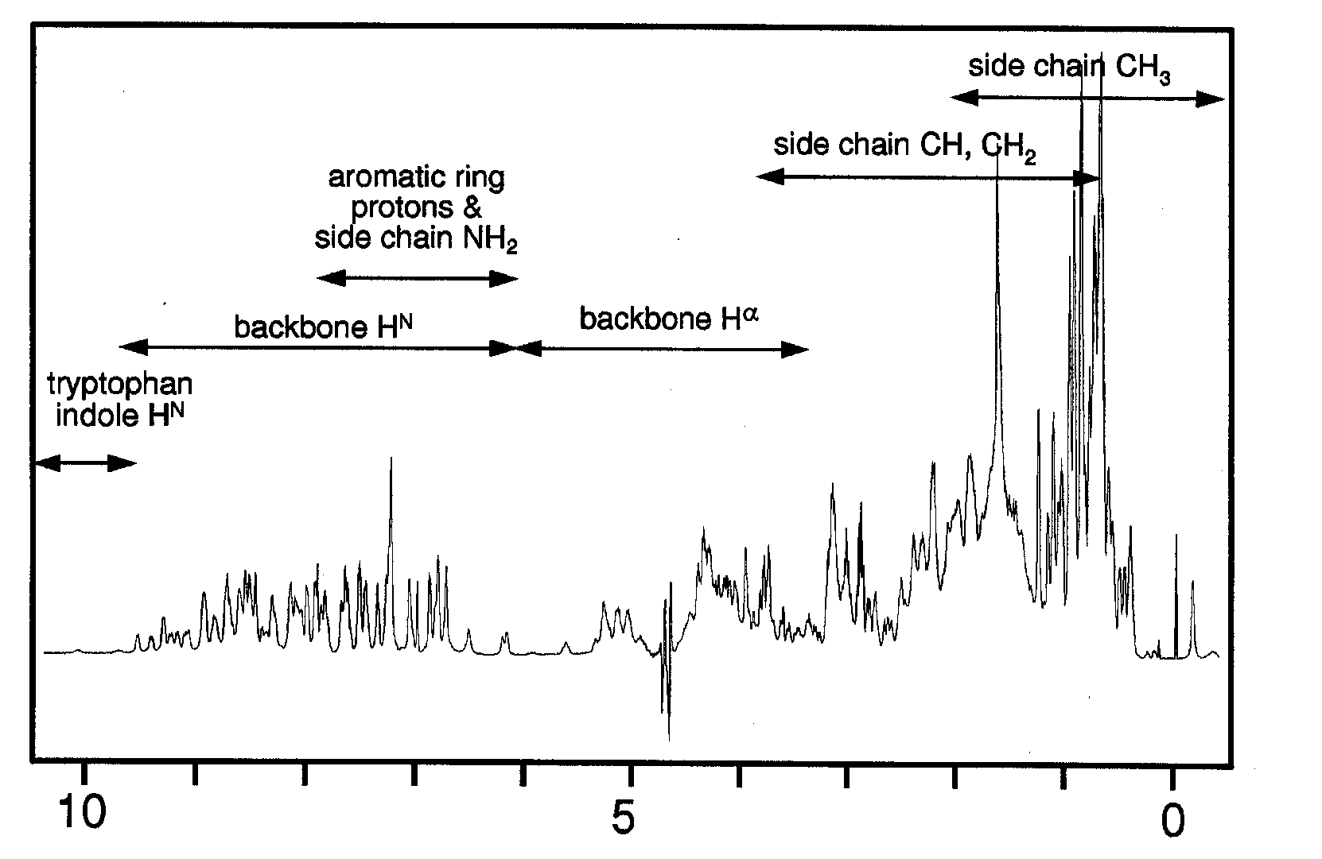
¹H chemical shifts in proteins
δ ¹H (ppm)

Slide 24
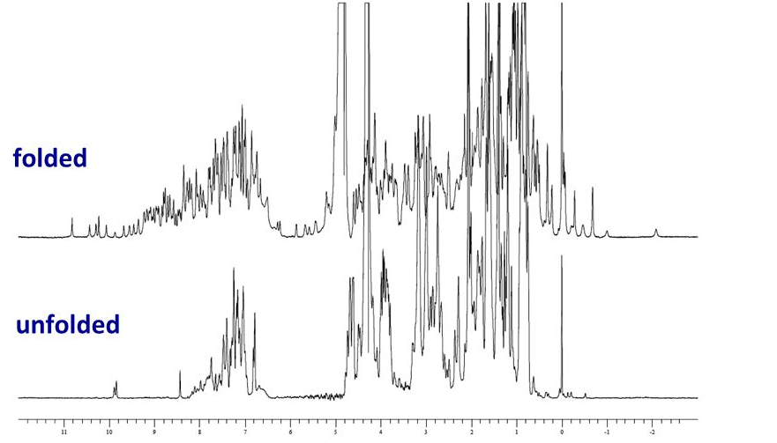
Protein folded or not? From inspection of ¹H spectrum
Protein folded
Protein unfolded
δ ¹H (ppm)

Slide 25
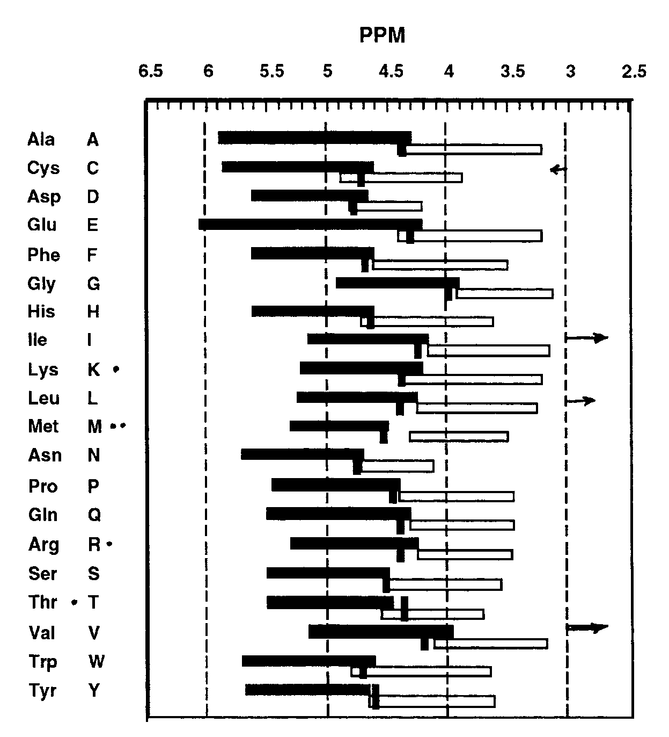
Secondary structure of each residue from ¹Hα chemical shifts
Random coil
β−sheet
α-helix
Same with ¹³CA, ¹³CB, ¹³CO → consensus

Slide 26
(2) Couplings = nucleus-nucleus interactions
Internuclear interactions (couplings) provide structural constraints
Dipolar (through space)
internuclear distances
Scalar (through bonds)
dihedral angles

Slide 27
Dipolar Interactions
Through space
Various mechanisms
One of them is the “nuclear Overhauser effect” (NOE)
NOE_{ij} ~ 1/r_{ij}⁶ → Main piece of information for structure determination by NMR, together with dihedral angles from chemical shifts
i-j: short range (sec. struct.) ; long range (tert. struct.)

Slide 28
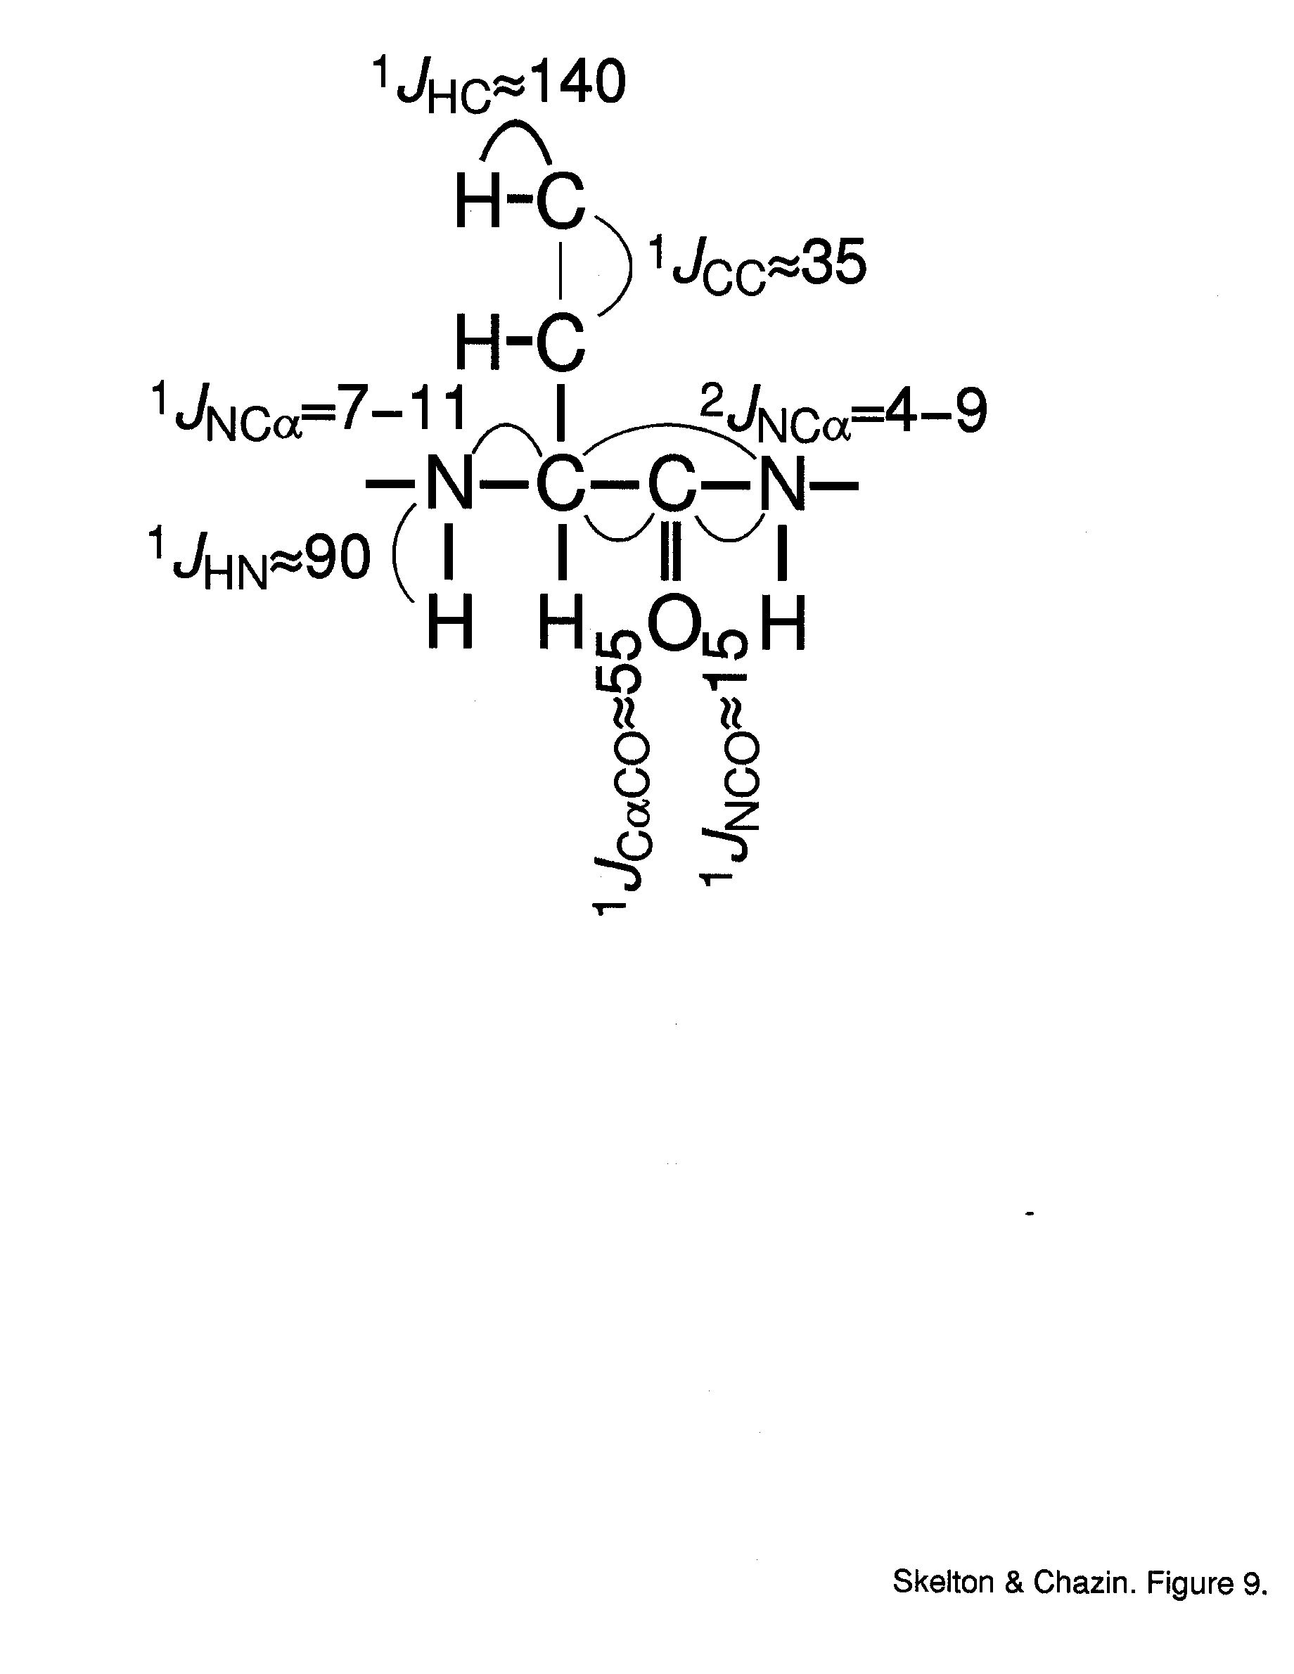
Scalar Interactions
Through bonds “couplings” (J)
Atom-atom and residue-residue connectivity
Dihedral angles
Example on two consecutive ¹³C,¹⁵N-labeled residues (all Js in Hz)

Slide 29
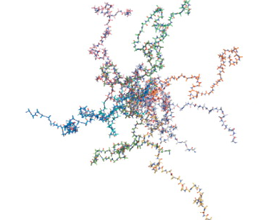
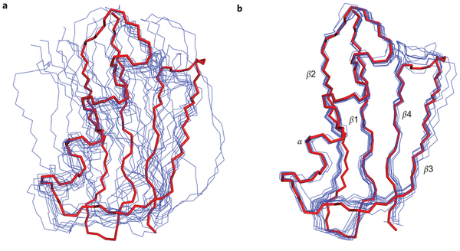
Structure determination by solution NMR
Simulated Annealing
Under NMR restraints (distances and angles)
Refinement
Random seed models
NMR-consistent ensemble

Slide 30
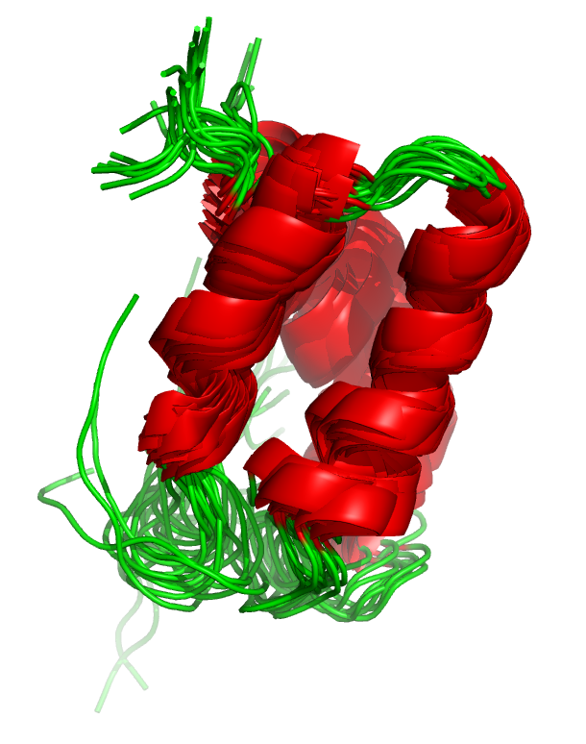
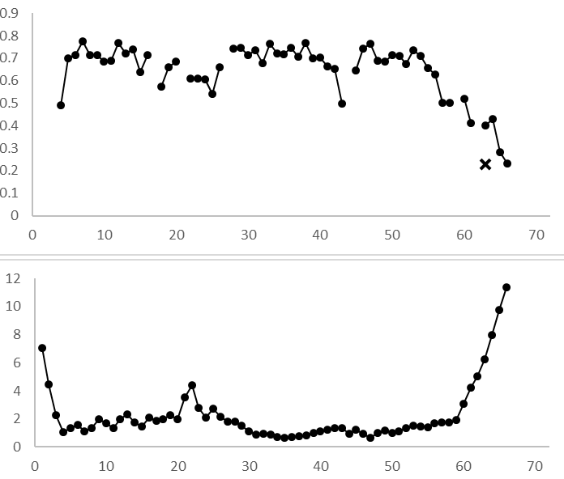
High NOE = rigid
Heteronuclear NOE
Low NOE = ps-ns flexible
Deviation from mean structure
Residue number
F. Sesterhenn , C. Yang, B. Correia

Slide 31
(3) Relaxation = rate at which
magnetization returns to equilibrium
Depends and reports on atomic motions in a large timescale
→ Next class

Slide 32
Part 3
Real spectra and data you get to see in papers
A quick look at some key spectra and concepts,
and we then move to hands-on work

Slide 33
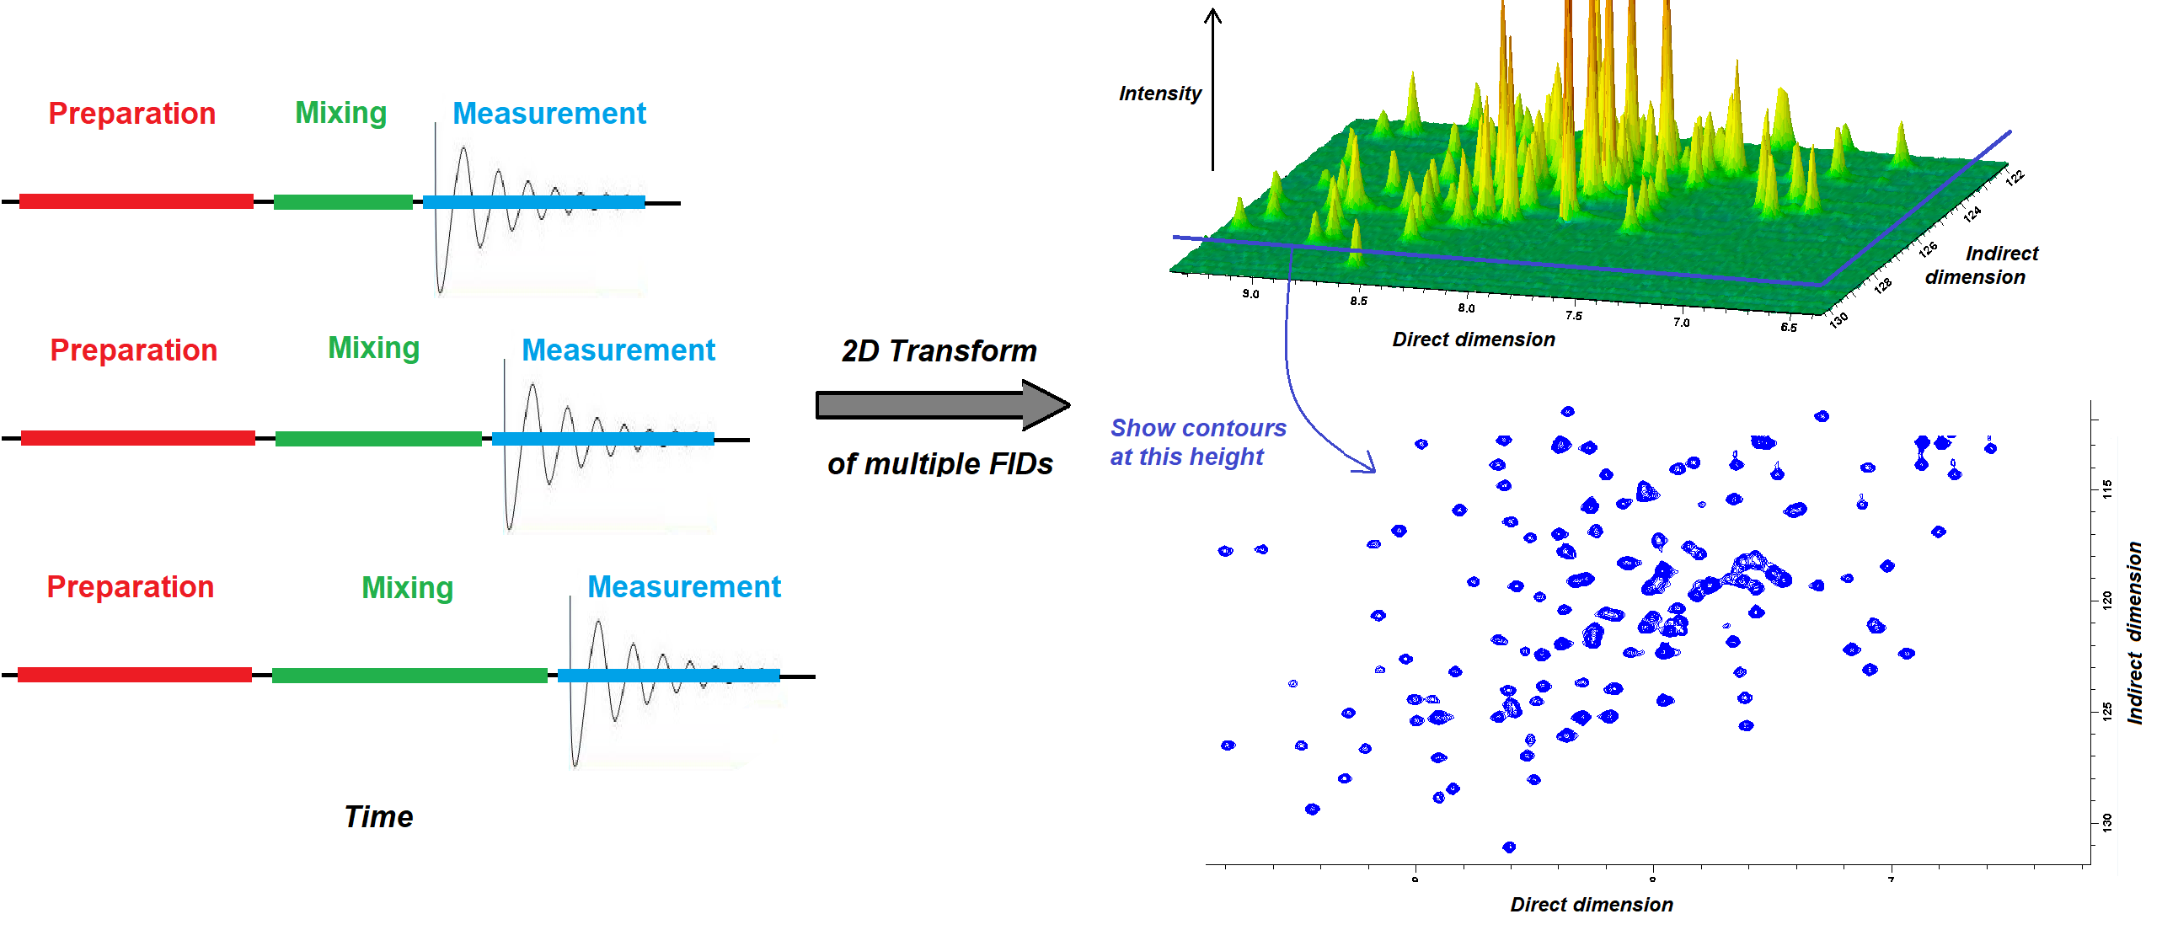
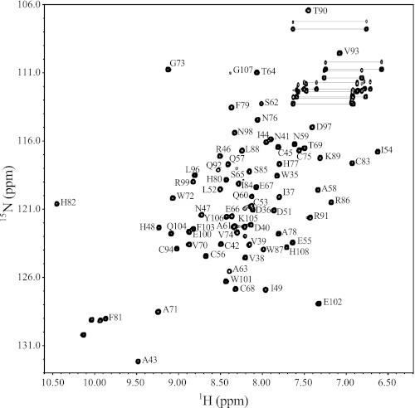
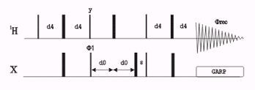
A very important 2D spectrum: ¹H-¹⁵N HSQC
INEPT (magnetization transfer)
(¹³C,¹⁵N…)
FID (becomes direct dimension upon FT)
1/J
X evolution
(becomes indirect dimension frequencies upon FT)
R
R
-¹⁵N - C_{α}- CO -¹⁵N - C_{α}
90Hz
H
H
2D ¹⁵N / ¹H correlation through a single bond,
One ¹⁵N-¹H per residue
2-5 min in perfect sample (even seconds with special pulse sequence) to a couple of hours for diluted/bad samples

Slide 34
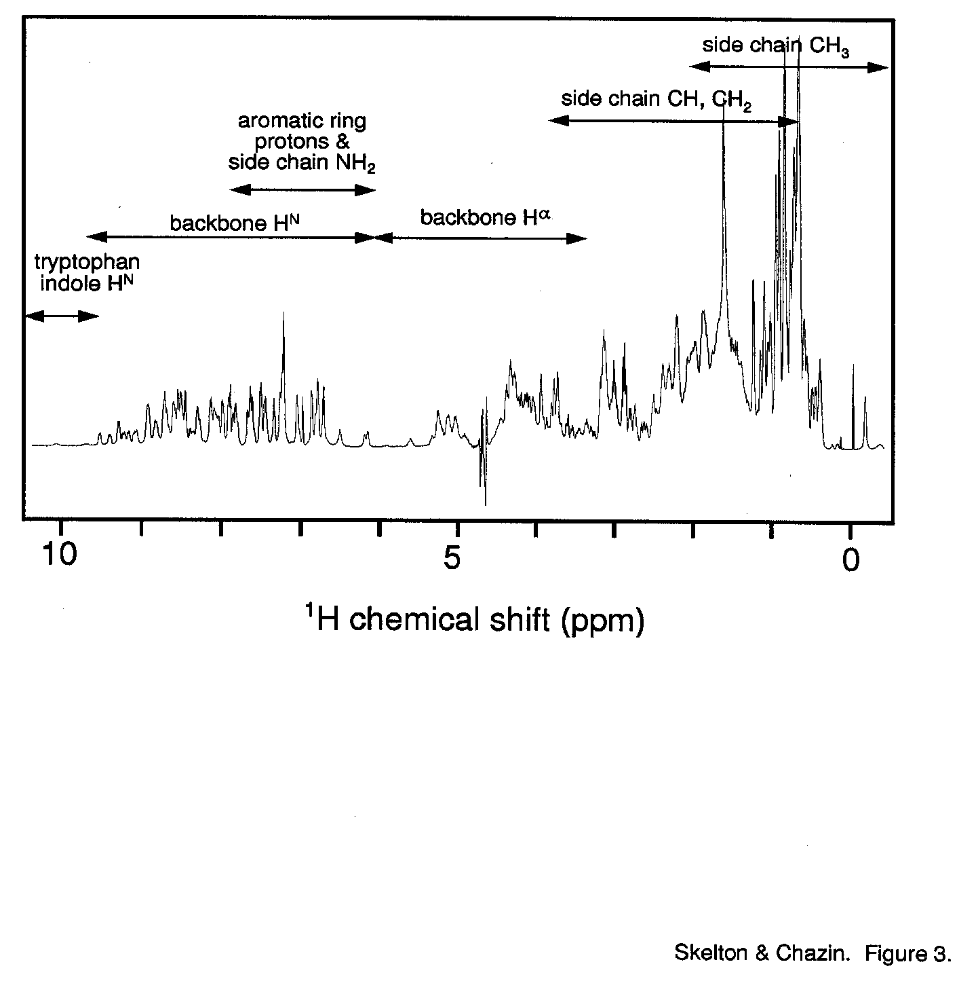
Very sharp resonances
1 per nucleus
Info on structure & dynamics
¹H,¹⁵N HSQC
¹⁵N & ¹³C “labeling”
Clear against ¹⁴N & ¹²C background
Resolve signals
More structural, chemical & dynamical information
¹⁵N
¹H
Notes:
Here you have a 1D spectrum of a ubiquitin. You can see how despite being sharp, the signals are so many that you have large overlap. You can alleviate this by resolving the resonances in 2D or 3D or moreD spectra, where you see crosspeaks only for pairs of atoms that are connected. The HSQC is especially important, and you have seen it a lot in publications for sure, because it gives a fingerprint of the backbone units quite easily, with high sensitivity, and is very robust. Each crosspeak in this 2D spectrum reports on one amino acid. Note how I’m talking about 15N. 1H here in this axis is the normal H, but abundant N is 14, not 15. So this means I have to incorporate 15N in the sample. I can also incorporate 13C. These “labels” are good not only because they are NMR active but also because they allow us to distinguish from the background, which is 14N and 12C. So we get resolution but also the possibility to see our protein in very complex environments, even full cells or highly concentrated solutions. Note that 14N and 12C are not radioactive, and do not entail any change in chemistry, compared to other probes.

Slide 35
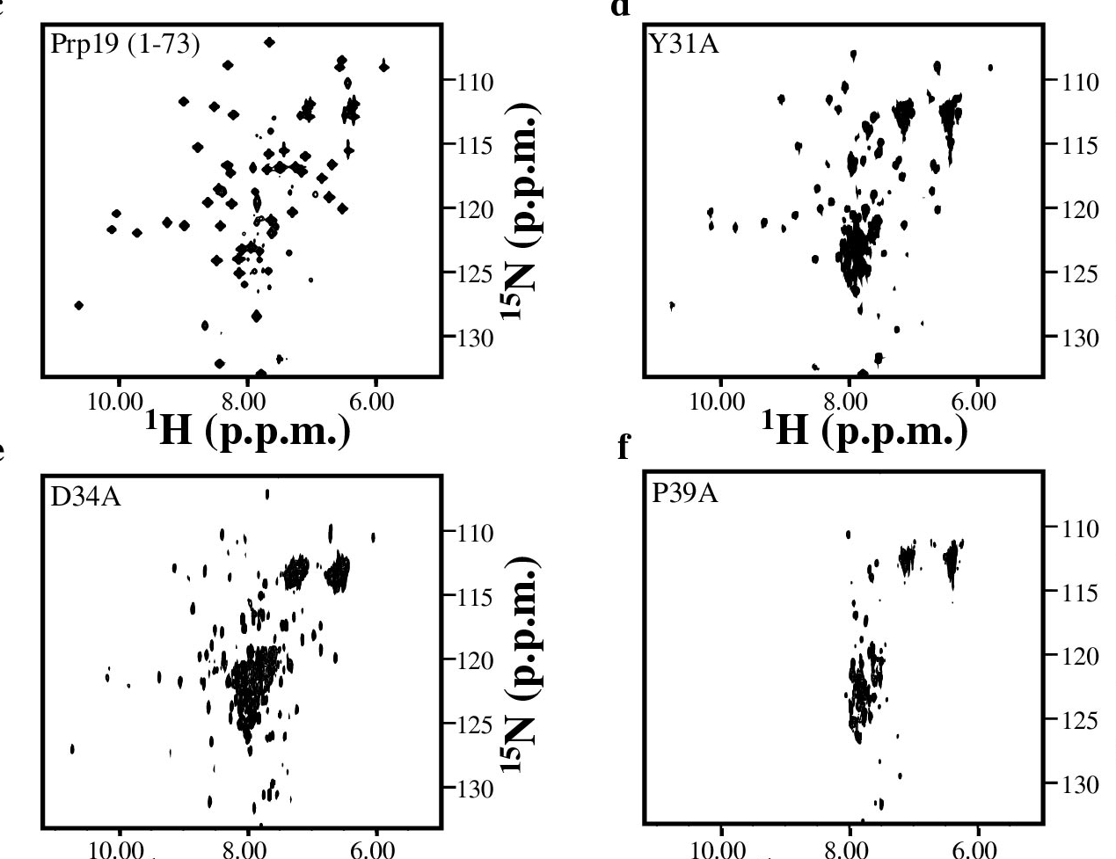
Quick Assay of Mutations Mutations can effect folding and stability
Wild type, well-folded
Partially destabilized
Partially destabilized & hetero-geneous
Unfolded, looks like an intrinsically disordered protein
Ohi et al., NSB (2003)

Slide 36
Resonance Assignment Assign each resonance to a specific atom
CH3-CH2-OH
OH
CH2
CH3

Slide 37
Proteins Have Too Many Signals! ¹H NMR Spectrum of Ubiquitin
~500 resonances
How to resolve and assign these spectra???

Slide 38
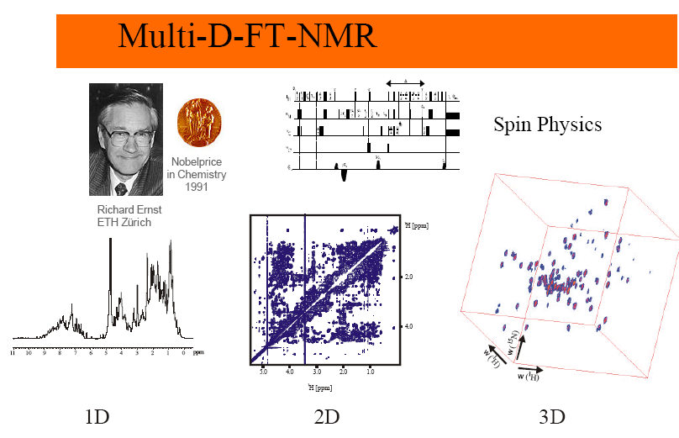
For proteins, additional dimensions provided by ¹³C and ¹⁵N

Slide 39
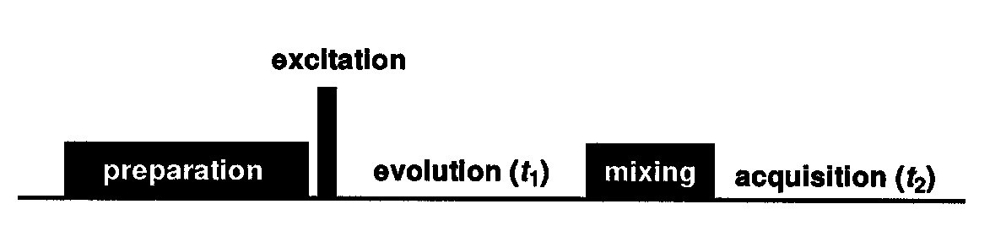
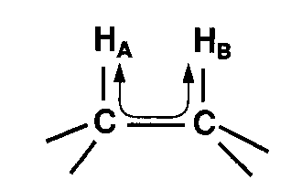
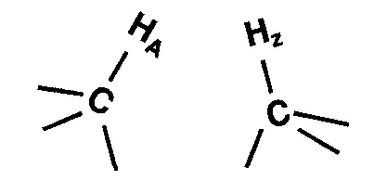
2D NMR: Coupling is the Key
2 times → 2 frequencies
90º pulse
t1
t2
t1
t2
Transfers between
coupled spins
Same as 1D experiment
2D NMR Pulse Sequences can be designed to selectively detect dipolar or scalar couplings
COSY & TOCSY type spectra: Scalar
NOESY: Dipolar

Slide 40
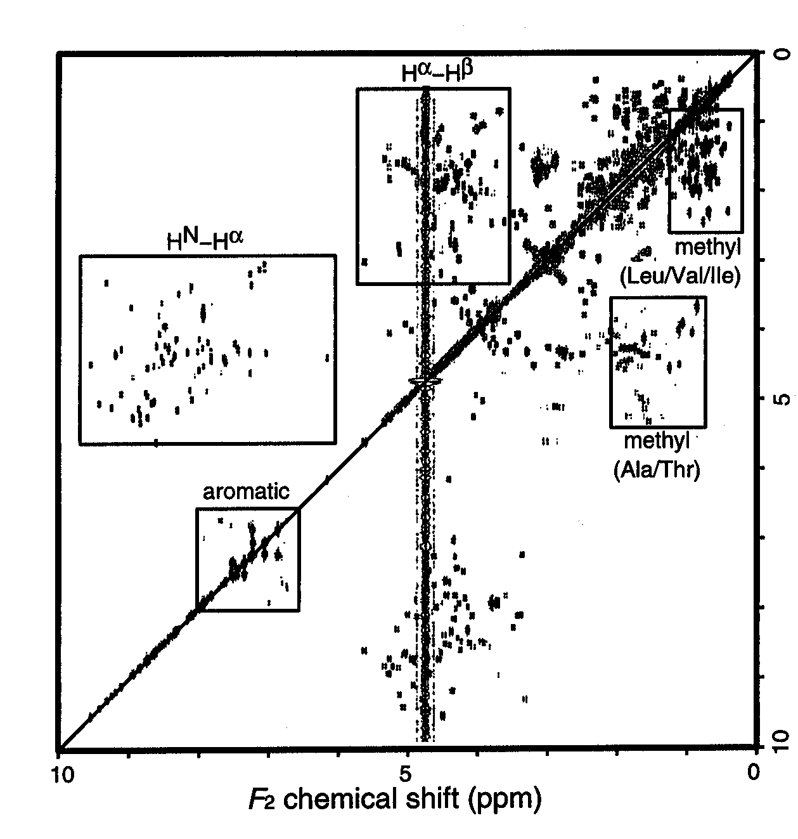
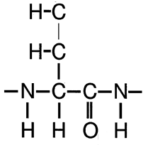
COSY:2D spectrum of ¹H-¹H scalar couplings
HG resX
HB resX
HA resX
¹H (ppm)
HN resX
HA resX
HB resX
¹H (ppm)

Slide 41
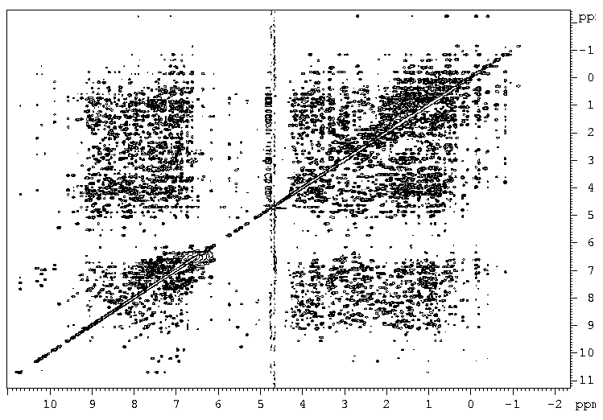
TOCSY: 2D spectrum of ¹H spin systems
HG
HB
HA
¹H (ppm)
HN resX
¹H (ppm)

Slide 42
NOESY: 2D spectrum of ¹H-¹H dipolar couplings
Hs from resX, resX-1..4, resX+1..4, and residues located far in sequence but close in structure
Hs from resX, resX-1..4, resX+1..4, and residues located far in sequence but close in structure
¹H (ppm)
residue j
HN resX
¹H (ppm)
HN resX
residue i
residue i+1

Slide 43
Assignments using ¹³C and ¹⁵N labeling Because ¹H – ¹H is not enough to overcome signal overlap and ¹H is not very informative per se

Slide 44
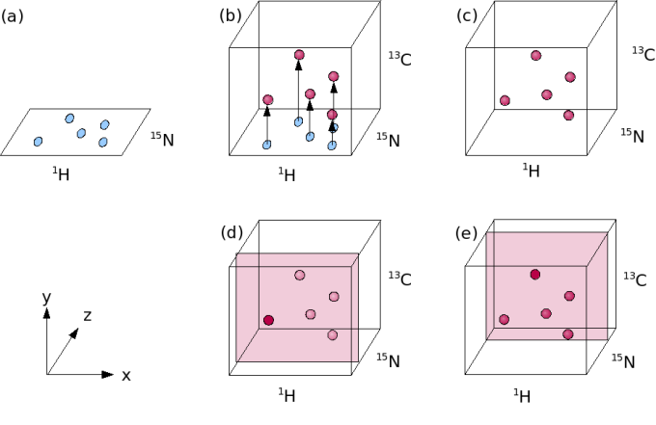
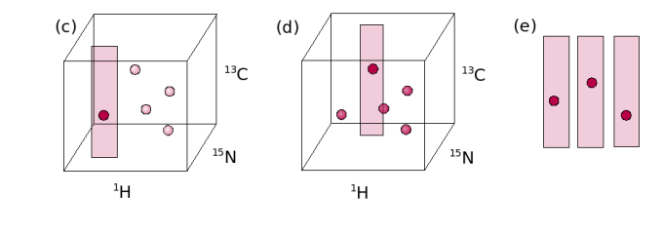
3D = HSQC + ¹³C dimension
(CO, CA, CB, CO-1, CA-1, CB-1)
HSQC
¹³C strips

Slide 45
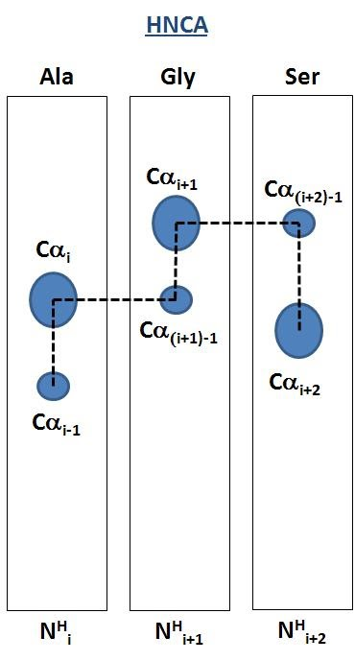

3D = HSQC + ¹³C dimension
(CO, CA, CB, CO-1, CA-1, CB-1)
HNCA

Slide 46
Result: An assigned HSQC spectrum

Slide 47
Part 4
Visit to the NMR facility and
hands-on work on some spectra (tomorrow)

Slide 48
Tomorrow at 8:15 SHARP in the entry to the BCH
Visiting the NMR center at 8:15 SHARP
Then back to this office, we’ll collect some spectra on a sample and look at them together
Resources you’ll need:
https://www.protein-nmr.org.uk/solution-nmr/spectrum-descriptions/
http://triton.iqfr.csic.es/guide/eNMR/proteins/aa/xxx.html (xxx = ala, arg, asp…)

Slide 49
Hands-on: Explore 2D and 3D spectra used to assign a protein, and complete assignments
Goals: To get familiar with navigating spectra, general info from chemical shifts, and more globally to demystify NMR.
Not goals: To learn all chemical shifts, pulse sequences or even spectra by heart, etc.
Resources you’ll need:
https://www.protein-nmr.org.uk/solution-nmr/spectrum-descriptions/
http://triton.iqfr.csic.es/guide/eNMR/proteins/aa/xxx.html (xxx = ala, arg, asp…)

